Slide 1
A Java OOP Security Suite: Q-Cloak
File Integrity, Keylogging, Metadata Removal, Password Management & Strength Checking

Slide 2
WHY Q-Cloak!
Combines multiple small utilities into one cohesive package
Address common security needs (file integrity, metadata removal, password management)

Slide 3
TABLE OF CONTENTS
01
02
03
04
Objectives & Scope
System Architecture
OOP Design Principles in Qloak
Individual Utility

Slide 4
01
Objectives & Scope

Slide 5
Objectives & Scope
Primary Objectives:
1.Monitor file integrity and detect tampering
2.Log keystrokes (for ethical pen-testing or analysis)
3.Strip sensitive metadata from documents/images
4.Manage secure storage of user credentials
5.Evaluate and enforce password strength

Slide 6
Scope & Limitations:
1.Runs on Java 8+ (cross-platform)
2.Console/UI-based (no full GUI framework)
3.Intended for educational/ethical use only (keys stored locally, not exfiltrated)

Slide 7
02
System Architecture

Slide 8
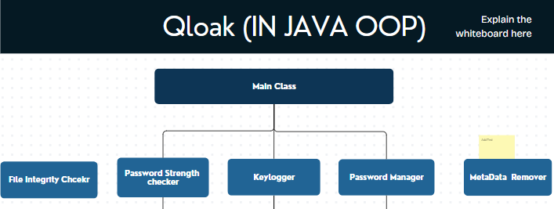
System Architecture
Modular Design:
Each utility is its own class, loosely coupled

Slide 9
03
OOP Design Principles in Qloak

Slide 10
Key Principles Demonstrated:
Encapsulation
Hiding internal data details
Restricting direct access to object’s internal state and methods
Polymorphism
Objects share common interface
Objects interact through shared interface but exhibit different behaviors
Inheritance
Subclass reuses parent functionality
Creating new classes from existing class properties and methods
Abstraction
Exposing essential interface only\
Simplifying complex systems by exposing only necessary functionalities

Slide 11
04
Individual Utility

Slide 12
FileIntegrityChecker.java
Purpose | Compute and verify file checksums to detect unauthorized modifications.
Methods | computeChecksums, verifyIntegrity, loadChecksumMap, updateChecksumMap.
OOP Highlights | Encapsulation of hashing logic, uses abstraction, modular class design

Slide 13
MetadataRemoverApp.java
Purpose | Remove sensitive metadata from files to protect user privacy.
Methods | Uses methods: removeImageMetadata, removeDocumentMetadata, detectFileType, saveSanitizedCopy.
OOP Highlights | Encapsulation of hashing logic, uses abstraction, modular class design

Slide 14
pwstrengthchecker.java
Purpose | Evaluate password strength and provide feedback for improvement.
Methods | Uses methods: calculateScore, isStrong, getRecommendations, loadDictionary, checkPatterns.
OOP Highlights | Encapsulation of scoring logic, uses abstraction, single-responsibility principle..

Slide 15
Keylogger.java
Purpose | Capture user keystrokes for security auditing and analysis.
Methods | Uses methods: startLogging, stopLogging, fetchLoggedKeys, writeLogToFile.
OOP Highlights | Encapsulation of logging logic, uses abstraction, observer pattern potential.

Slide 16
pwmanager.java
Purpose | Securely store, retrieve, and manage encrypted user credentials locally.
Methods | addCredential, getCredential, deleteCredential, encryptPassword, decryptPassword.
OOP Highlights | Encapsulates credential logic, uses abstraction for encryption, composition with Credential class.

Slide 17
Future Enhancements
GUI addition
Expand Supported File Types
Multi-Platform Keylogger Options
Migrate from console menus to a simple Swing or JavaFX UI
Metadata remover → support Office 2007+ formats (PowerPoint, Excel).
Refactor Keylogger to work on Linux/macOS

Slide 18
“
—SOMEONE FAMOUS
“Trusting your computer’s security without checks is like leaving the front door wide open—fun until the burglar parties inside.”

Slide 19
END

